Slide 1
MAC LAYER IN WIRELESS SENSOR NETWORKS
APRIL 5, 2017
A PRESENTATION BY:
ABHILASH REDDY TATHIREDDY
SIDDHARTH GURRAMKONDA
MANIRATNAM PALKUR.

Slide 2
OVERVIEW
INTRODUCTION
UNDERSTANDING WSNs
STRUCTURE OF WSNs
MAC LAYER
CURRENT SCENARIOS IN MAC
EXPERIMENTS
CONCLUSION

Slide 3
INTRODUCTION
What is a wireless sensor network?
A wireless sensor network (WSN) is a remote system comprising of spatially conveyed independent devices that utilize sensors to cooperatively screen physical or natural conditions, for example, noise, vibration, temperature, mass, movement, or poisons at various locations.
WSN(Wireless sensor networks)s have been growing fast since last few years. The goal of a WSN is to gather and process information from an objective area and transmit data back to specific sites. WIRELESS sensor networking is an emerging technology that has a wide range of potential applications including environment monitoring, smart spaces, medical systems and robotic exploration.

Slide 4
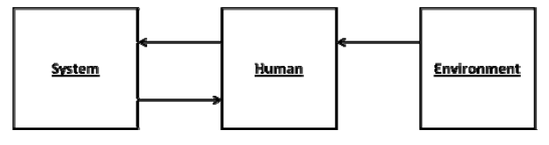
UNDERSTANDING WSNs
Before continuing with the Wireless Sensor Network, we must realize the need and conditions which prepared to the creation of Wireless Sensor Network.
System Human Interaction

Slide 5
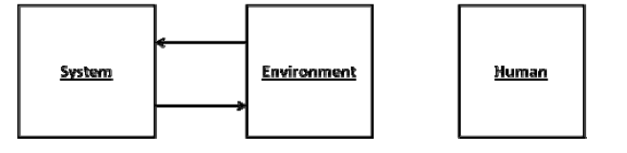
Continued…..
System Environment Interaction
This technology is known as “The Ambient Intelligence”. Ambient means surrounding which implies providing intelligence to the surrounding.
The absolute combination of "User – System – Physical Environment.

Slide 6
Continued….
This type of network has many applications. Their application may range from military services, medical to disaster relief operations. Basically for this imagination to become reality we need to develop devices which are very small but have the following capabilities:
Processing power for onboard processing
Transmitter and Receiver
Power Supply
Sensors to interact with Physical environment

Slide 7
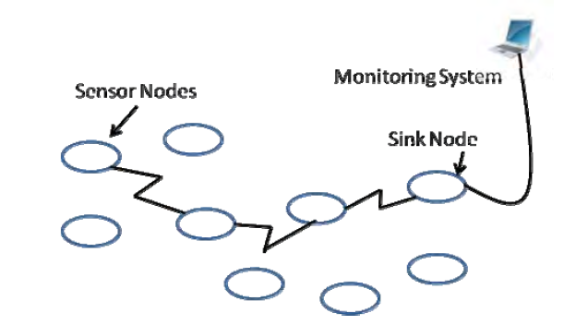
STRUCTURE OF WSNs
Nodes
Sink
Monitoring system

Slide 8
MAC(Media Access Control) LAYER
In wireless sensor networks media access control (MAC) layer is an imperative layer. Medium access control (MAC) is an important technique that ensures the successful operation of the network. One of the main functions of the MAC protocol is to avoid collisions from interfering nodes.
OBJECTIVES OF MAC:
Creation of the sensor network infrastructure.
Share the communication medium fairly and efficiently:
Energy efficiency
Latency
Throughput
Fairness

Slide 9
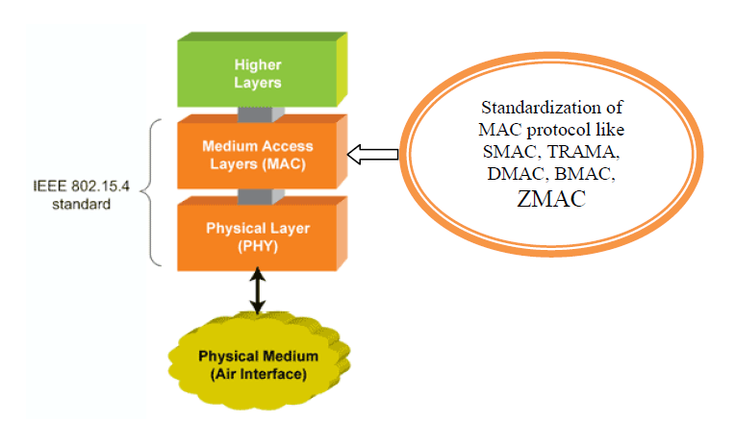
STRUCTURE OF STANDARD MAC PROTOCOL

Slide 10
Continued….
A MAC protocol provides slightly different functionality depending on the network, device capability, and upper layer requirements, but several functions exist in most MAC protocols. In general, a MAC protocol provides:
Framing
Medium access
Reliability
Flow control
Error control

Slide 11
Current Scenarios in MAC( Different types of MAC protocols):
Sensor MAC(S-MAC) :
Pattern MAC(P-MAC):
Traffic-Adaptive MAC(TARAMA):
A versatile low power MAC(B-MAC):
X-MAC, a Short permeable MAC:
T-MAC Time out MAC.

Slide 12
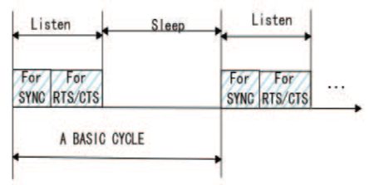
S-MAC (Sensor MAC)
S-MAC is mainly designed to extend the network lifetime by using the listen or sleep frame and also to reduce the energy consumption.
In S-MAC during sleep time, nodes shut down transceivers to save energy.
In wake-up time, sensor nodes become connected with each other and transmit a several number of control messages such as, synchronization(SYNC) acknowledgement (ACK) , request to send(RTS), clear to send(CTS).

Slide 13
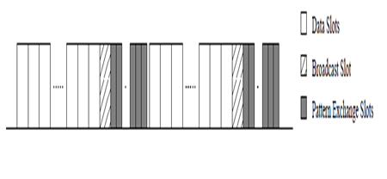
P-MAC (Pattern MAC): -
In the proposed Pattern-MAC (PMAC) protocol, instead of having fixed sleep- wakeups, the sleep-wakeup schedules of the sensor nodes are adaptively determined.
The schedules are decided based on a node's own traffic and that of its neighbors.
PMAC achieves more power savings under light loads, and higher throughput under heavier traffic loads.

Slide 14
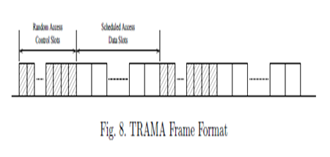
TRAMA (Traffic-Adaptive MAC ) : -
TRAMA protocol attempts to stabilize the uses of scheduled and unscheduled protocols by making availability of scheduled slots with no disagree for a longer data messages and different access slots for small, periodic control messages.
This protocol consists of 3 components.

Slide 15
B-MAC
It is a versatile low power MAC protocol.
B-MAC is designed for an Ad-Hoc network of nodes with N-sender to 1-receiver transmissions.
The basic idea of B-MAC is to keep the protocol simple.
The node wakes up at every check interval, in which the radio samples the channel and verifies that if any activity is took place during the preamble period.

Slide 16
X-MAC
X-MAC is meant for ad-hoc structure, too. It uses asynchronous wake-up schedules like B-MAC.
X-MAC tries to improve B-MAC by sending more intelligent announcements.
This protocol solves the P-MAC issues which ae embedding the target ID in the preamble so that the other node can go back to the sleep.

Slide 17
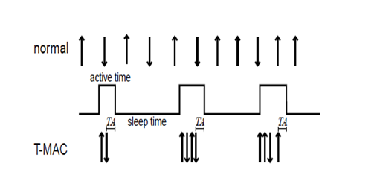
T-MAC (Time-Out MAC)
This MAC protocol is similar to S-MAC in which this utilizes a wake/sleep duty cycle.
Activation event is:
1.Discharge of a periodic frame timer.
2.Response of any type of data on the radio.
3.Sensing of communication on the radio.
4.End-of transmission of a node’s own data packet.
The main idea behind the design of T-MAC is, while latency requirements and the spaces between the buffers are generally fixed and the message rate will vary

Slide 18
Determining TA:
The interval TA must be long enough to receive at least the start of the CTS packet.
TA: TA > C + R + T
where C, is length of conventional interval
R is the length of an RTS packet
T is the turn-around time (i.e. the short time between the beginning of the CTS packet and start of the RTS packet).
A larger TA increases the energy used.

Slide 19
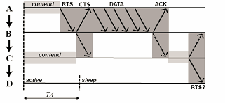
Problems in TMAC:
The node-to-sink communication pattern causes, early sleeping problem reduces the total possible throughput of T-MAC to less than half of the maximum throughput of traditional protocols or S-MAC
It is believed that, the problem might occur in any asymmetric communication pattern.

Slide 20
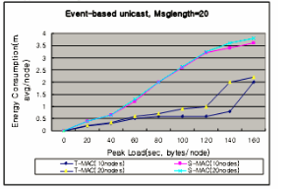
Experimental Results:
T-MAC uses much less energy than the S-MAC, especially when the message frequency during events increases.

Slide 21
Power usage:
The message length is 20 bytes. The voltage over the resistor is a measure for the electrical current.

Slide 22
Conclusion:
The reduction of the power consumption is one of the major issues in WSNs, and the efficient management of the radio transceiver is the key element to achieve this objective.
The performance of T-MAC under low peak load having a low traffic is better than the S-MAC in same condition in small networks.
Since when it is consider for saving energy in WSN, TMAC is better when compared to the other MAC protocols.

Slide 23
References: -
Ramadan, Khalil F., M. I. Dessouky, Mohammed Abd-Elnaby, and Fathi E. Abd El-Samie. "Energy-efficient dual-layer MAC protocol with adaptive layer duration for WSNs." 2016 11th International Conference on Computer Engineering & Systems (ICCES) (2016): n. pag. Web.
Dam, Tijs Van, and Van Langendoen. "An Adaptive Energy-Efficient MAC Protocol for Wireless Sensor Networks." (2003): n. pag. Web.
Mainetti, Luca, Vincenzo Mighali, and Luigi Patrono. "HEC-MAC: A Hybrid Energy-Aware Cross-Layer MAC Protocol for Wireless Sensor Networks." International Journal of Distributed Sensor Networks 11.4 (2015): 536794. Web.
Gunn, Meghan, and Simon G. M. Koo. "A Comparative Study of Medium Access Control Protocols for Wireless Sensor Networks." International Journal of Communications, Network and System Sciences 02.08 (2009): 695-703. Web.
Sumita, Nagah. "Hyrbrid MAC protocols for wireless sensor network.
" International Journal of Emerging Technologies in Computational and Applied Sciences (IJETCAS) (n.d.): n. pag. Web.
KHATARKAR, Sarika. "Wireless Sensor Network MAC Protocol: SMAC & TMAC. " Indian Journal of Computer Science and Engineering (IJCSE) 4th ser. 4 (2013): n. pag. Web.

Slide 24

Thank you!!!

